Slide 1

Critical Steps to AM Revitalization
Presented by
Tom F. King, President
Kintronic Labs, Inc.
PO Box 845
Bristol, TN 37621-0845
www.Kintronic.com

Slide 2
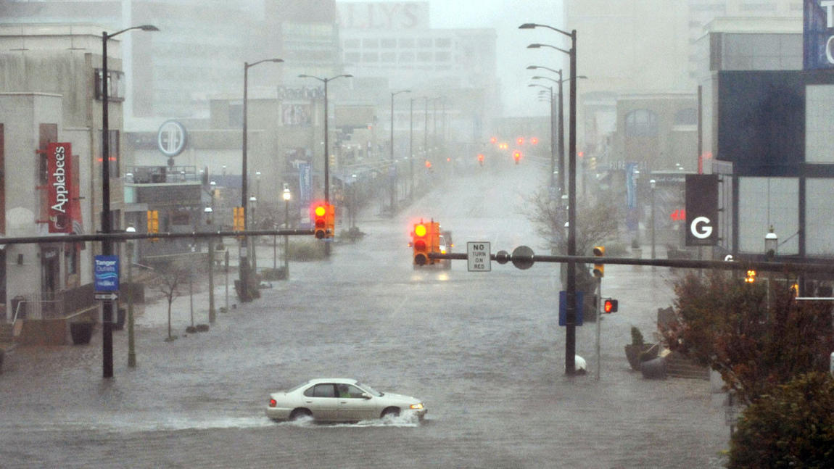
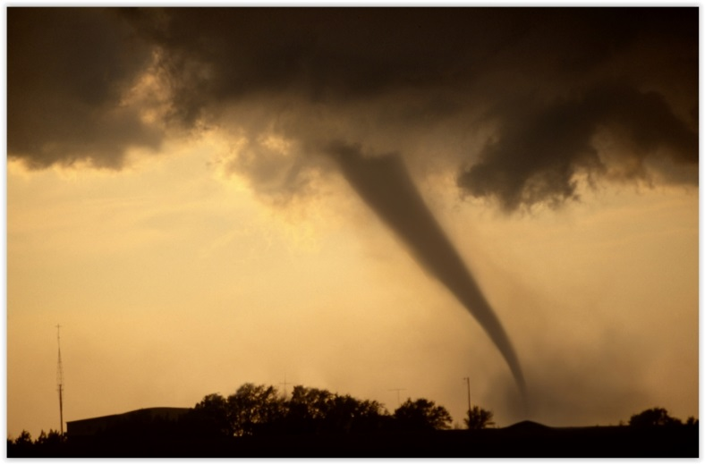
Why AM Radio as a Media Resource is Irreplaceable
During Hurricanes Katrina and Sandy AM Radio Stations With Available Diesel Generator Power Proved to Be the Most Reliable Source of Information
During the Earthquake in Northern VA that shook downtown Washington, DC AM Radio Stations were again a primary source of news and information when cell sites were totally saturated with users
AM Radio Stations Cover a Larger Demographic Area Than FM or TV Stations, Particularly at Night Due to Over the Horizon Skywave Coverage

Slide 3
AM Radio is in Dire Straits
Listenership fading steadily (<17%)
  High levels of reception noise (RFI/EMI)
  Absolute dominance of FM radio
  Internet radio, MP3 players, personal devices
Total revenue is $2.2 B but falling
  Mostly from large markets, chains (2012 figures)
  Many small-market stations near failure
What’s the real problem?
  Poor reception conditions, poor AM radio receivers
  Terrible audio quality (2.5-kHz typical bandwidth, no bass)
  With the low audio quality, it’s hard to program music
  AM cannot survive with news/talk alone!

Slide 4
Three Paths Forward for AM
(1) Continue current course:
  No significant actions; some minor (helpful) Rules changes
(2) Order analog “sunset”:
  With sufficient HD radio penetration (2019?)
  Abrupt, large loss of audience; economic shock
(3) Three Critical Steps to AM Revitalization
  Conduct a noise study in the 0.5MHz-2GHz band and review and modify as appropriate the Part-15 and Part-18 EMI regulations
  Establish AM receiver specs to provide parity with FM
  Promptly adopt AM synchronization rules

Slide 5
Legal Precedents for Strong Action
The Commission has proactively managed the broadcast services in the past:
  Denial of AM stereo in 1961 to assure success for FM
  Adoption of FM stereo standard (1961)
  UHF-TV floundering; All-Channel Receiver Act passed (1961)
  Commission solicited AM stereo proposals (~1979-80)
  Magnavox CPM system selected (1980); lawsuits threatened
  Commission adopted “marketplace approach” (1982) ⇒ failure for AM!
  TV stereo (BTSC) adopted by industry with Commission blessing (1984)
  AMAX receiver standards (1993); no Commission mandate ⇒ failure
  Final CQUAM approval in 1993; too late without receiver mandates
AM has been left to drift too long; the situation is now desperate!
Industry will not move on its own, so it’s up to the Commission to move in the public interest to preserve AM

Slide 6
Projected AM Listenership
25
Active EMI Enforcement
Total Radio Audience (%)
20
17
AM Receiver Specs adopted
15
All-Digital
11.5
10
Avg. AM Survival Threshold (est.)
5
Analog Sunset
(projected)
Current Path
0
Path – L.A. Times
Time
2014
2016
2018
2020
2022
Scenarios versus estimated AM survival share threshold
Aggressive, prompt action is needed to save AM radio!

Slide 7
Part-15 EMI Enforcement:
“Do or Die” for AM Radio
AM is slowly drowning in a sea of noise (QRM)! Analog & Digital
  Power lines (high & low-voltage) – poor maintenance
    Bad insulators, bushings, arcing transformers
    Ineffective RFI suppression & grounding
    Proximity to roads
  Telephone, cable feeders (DSL, CATV signal leakage)
  Consumer devices with radiation & shielding issues
    Computers, modems, switching power supplies, etc.
    Fluorescent & LED lamp ballasts, dimmers
    LCD & plasma HDTV sets, home A/V gear
The legal solution requires active enforcement now!
  Part-15 Rules need to be re-evaluated respective to the present noise environment:
    Unintentional Radiators (§47 CFR 15, Subparts A & B [15.209, 15.221])
    Intentional Radiators (§47 CFR 15, Subparts A & C)
    Home devices (Digital Devices Part B)

Slide 8
Part-15 EMI Enforcement:
“Do or Die” for AM Radio
FCC Lab should demand valid Part-15 certification from vendors (e.g., Wal-Mart, Sears, Best Buy, Amazon) & perform random product testing to assure compliance.
Noncompliance should result in hefty fines and (in egregious cases) even marketing injunctions.
AM stations must become actively involved in reporting Utility & Home Device Part-15 offenses to the Commission.
Public (non-technical) interference complaints would be directed to the affected stations for follow-up.

Slide 9
INSTRUCTIONS FROM FCC COMMISSIONER MIGNON CLYBURN REGARDING INTERFERENCE COMPLAINTS
· Submit a filing for the public record at http://apps.fcc.gov/ecfs/
o Find the most active open proceedings at http://fcc.us/1ILis9g
o Please note that all submissions are publicly available and searchable on the internet
· File a complaint about a telecommunications related service at http://www.fcc.gov/complaints
· File a complaint over the phone or ask general questions about the FCC: (888) 225-5322
Ref: Email from Commissioner Clyburn to Tom King dated 12 Nov 2014 at 5:32PM.

Slide 10
RECENT ARTICLES ATTESTING TO BROADBAND SPECTRAL NOISE AS A MAJOR WIRELESS COMMUNICAITONS PROBLEM
“Electronic Noise is Drowning Out the Internet of Things” by Mark A. Henry, Dennis Roberson & Robert J. Matheson, posted in IEEE Spectrum 18 Aug 2015
ITU Report entitled “Drowning in a Sea of Man-Made Noise”, IEEE BTS Broadcast Technology Magazine, August 2015

Slide 11
NEED FOR RF NOISE STUDY
“There hasn’t been a systematic study of radio-frequency noise in the US since the mid-1970’s, when the Institute for Telecommunications Sciences(ITS), a part of the National Telecommunications and Information Administration, last monitored federal use of the radio spectrum.”
* Ref: “Electronic Noise is Drowning Out the Internet of Things”(Note previous slide for details.)

Slide 12
AM Receiver Mandates: Parity with FM
Low internal noise floor
High overall RF sensitivity, selectivity, and dynamic range
Highly effective noise (EMI) rejection
Full 10-kHz audio bandwidth capability with low detector distortion.
Stereo capability

Slide 13
AM Receiver Mandates: Parity with FM
Audio Bandwidth: 9-10 kHz typical, adaptive with a minimum nominal bandwidth of 7.5 kHz; reduced adaptive bandwidth (~ 3-kHz minimum) permitted in high noise or adjacent-channel interference situations (i.e., nighttime). Variable-Q notch filter @ 10 kHz standard.
Signal-to-Noise Ratio (SNR): minimum 55 dB, preferably ≥ 60 dB.
Sensitivity: -120 dBm (~1 μV) for 10 dB SNR; <20 μV for 20-dB SNR.
Selectivity: 25-50 dB (adaptive, using co-, adjacent-and alternate- channel detection).
Dynamic Range: ≥ 100 dB.
Noise Figure/Rejection: ≤ 6 dB; 2-3 dB preferred/≥30 dB impulse noise rejection.
Image Rejection: 50 dB or better.
Intermodulation: IP_{2 ,} IP₃ intercepts +10 to +40 dBm.
IF: low with image-rejecting down-conversion, or alternatively, double (up-down) conversion.
Stereo Separation: minimum 25 dB, 30 Hz - 10 kHz.
Antenna: H-field, or combination H & E field, diversity-type preferred.

Slide 14
AM Receiver Mandates: Parity with FM
Specification | FM (Current) | AM (Current) | Parity? | AM (New) | Parity?
Audio Bandwidth | 15 kHz | 2.5 kHz | No! | 10 kHz | Close
Signal/Noise | 65 dB | 35 dB | No! | 55 dB | Close
Sensitivity (20 db SNR) | 2 μV | 500 μV | No! | 20 μV | Close
Selectivity (Adj./Alt.) | 45/60 dB | 40/50 dB | Close | 40/50 dB (Adaptive) | Yes
Dynamic Range & Intercepts | 100 dB | 70 dB/ 0-10 dBm | No! | 100 dB/ +10-40 dBm | Yes
NF/Noise Rejection | 3/50 dB | 14/20 dB | No! | 2-3/50 dB | Yes
Image Rejection | 60 dB | 30-40 dB | Close | 50 dB/50 dB | Yes
Stereo Separation | 35 dB | ------ | No! | 25-30 dB | Yes
Antenna | E-field (Fair) | E-field (Poor) | No! | H-field/ Diversity | Yes

Slide 15
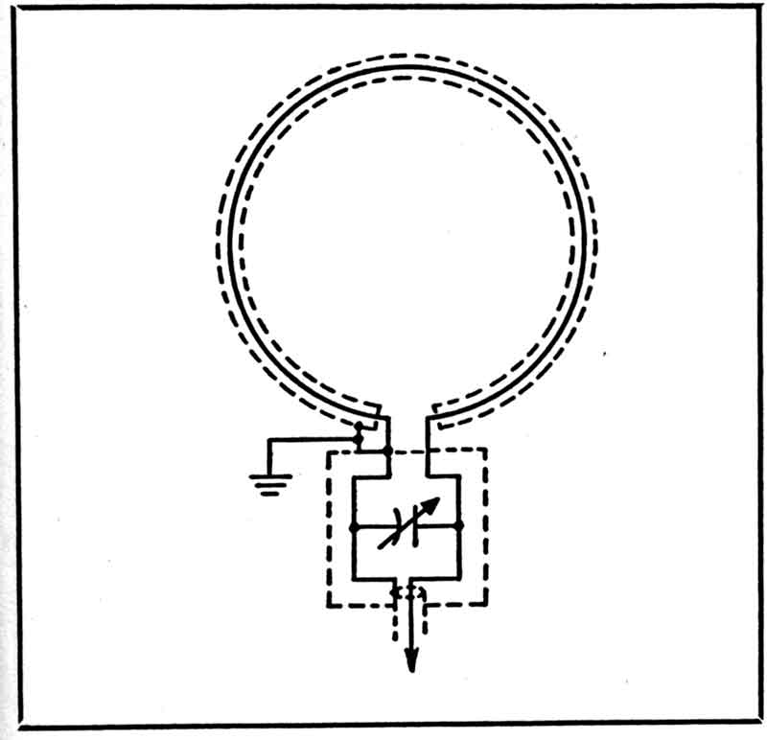
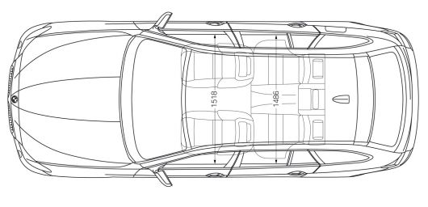
Vehicle H-Field Antenna Implementations
Typical tuned, shielded loop
Potential Loop Locations
A shielded loop permits good magnetic (H) field AM signal reception while screening out local E-field noise from auto electronics & power lines.
Loop-antenna units (including ferrite loopsticks) can be fabricated at low cost and mounted in windshields, windows, trim, and under plastic body panels.
Multiple air-core units, mounted vertically, can be effectively utilized with standard diversity-combining techniques.
These AM loops can be configured for good FM reception as well.

Slide 16
FM vs. AM Audio Frequency Response
AM (Transmitted –NRSC)
FM (Transmitted & Received)
AM (Typical Received)
0
2.5
5
7.5
10
12.5
15
17.5
FM transmitted & received bandwidth ~ 15 kHz (“full-fidelity”)
AM transmitted bandwidth (NRSC) ~ 10 kHz (“fine”)
Typical AM receiver ~ 2.5 kHz + bass rolloff + noise (“telephone-grade”)
With these conditions, how can AM compete or even survive?

Slide 17
AM Reception Cases
0.25 mV/m
0.5 mV/m
③
②
.
Adjacent-Channel Station
2 mV/m
①
10 mV/m
Protection Ratio: 6 dB
Contours: (1) Close-in [10 mV/m]; (2) Suburban [2 mV/m]; (3) Fringe [0.5 mV/m].
Receiver response dependent on relative carrier & modulation levels.
Dynamic bandwidth, signal cancellation, and audio expansion performed digitally for higher performance plus lower cost & complexity.
Overall cost/complexity comparable to HD radio implementations.

Slide 18
AM Receiver Frequency Response
On-channel signal
f_{C}
0 dB
Typical AM receiver response (~2.5 kHz)
Transmitted spectrum (NRSC, ~10 kHz)
Alternate-channel signal
f_{UAlt} (+20 kHz)
f_{LAdj} (−10 kHz)
Adjacent-channel signal
Current AM receivers reproduce only ¼ of the transmitted bandwidth!
To “balance” the sound, the bass is cut to compensate for the lack of highs
Current receivers have no stereo, no noise limiting, poor RF performance

Slide 19
AM Receiver Frequency Response
Close-in (10 mV/m)
f_{C}
0 dB
Maximum AM receiver response (>9 kHz)
Transmitted spectrum (NRSC, ~10 kHz)
Alternate-channel signal
f_{UAlt} (+20 kHz)
f_{LAdj} (−10 kHz)
Adjacent-channel signal
−32 dB
Co-Channel Carrier: −52 dB
New AM receivers can reproduce all of the transmitted bandwidth!
Flat bass response, extended highs, and full stereo separation (CQUAM)
Multi-stage noise limiting, low internal receiver noise, H-field antennas

Slide 20
AM Receiver Frequency Response
Suburban signal (2 mV/m)
f_{C}
0 dB
Adaptive AM receiver response (avg. ~7 kHz)
Transmitted spectrum (NRSC, ~10 kHz)
Alternate-channel signal
f_{UAlt} (+20 kHz)
f_{LAdj} (+10 kHz)
Adjacent-channel signal
−18 dB
Co-Channel Carrier: −38 dB
Adaptive AM receivers can reproduce most of the transmitted bandwidth!
Bandwidth dynamically controlled by noise, adjacent- & alternate-channel levels
Advanced DSP algorithms for optimized reception, adaptive noise reduction

Slide 21
AM Receiver Frequency Response
Fringe signal (0.5 mV/m)
f_{C}
0 dB
Adaptive AM receiver response (~3-7 kHz; typ. 5 kHz)
Transmitted spectrum (NRSC, ~10 kHz)
Alternate-channel signal
f_{UAlt} (+20 kHz)
f_{LAdj} (−10 kHz)
−6 dB
Adjacent-channel signal
Co: −26 dB
Co: −36 dB
Co-Channel Carrier: −26 dB
Adaptive AM receivers can still reproduce most of the transmitted bandwidth!
Bandwidth dynamically controlled by noise, adjacent- & alternate-channel levels
Aggressive DSP algorithms for optimized reception, adaptive noise reduction

Slide 22
AM Receiver Frequency Response
Suburban nighttime signal (2 mV/m) – Class B
f_{C}
0 dB
Transmitted spectrum (NRSC, ~10 kHz)
Adaptive AM receiver response (LSB rejected; ~7 kHz on USB)
[SSB or VSB processing as needed]
Alternate-channel signal (skywave)
f_{UAlt} (+20 kHz)
f_{LAdj} (−10 kHz)
−18 dB
Adjacent-channel signal (skywave)
Co: −38 dB
−46 dB
Co: −48 dB
Overlapping sideband suppressed 20 dB
Co-Channel Carrier: −38 dB
Adaptive AM receivers can still reproduce most of the transmitted bandwidth!
Bandwidth dynamically controlled by noise, adjacent- & alternate-channel levels
Aggressive DSP algorithms for optimized reception, adaptive noise reduction; e.g., asymmetric filtering, SSB/coherent techniques, interference cancellation

Slide 23
Typical Advanced Receiver Architecture
FM RF Front End
Quadrature FM Mixer
I-Ch. Low-IF
ADC
External DSP
(Optional)
DAC
Amp
DSP
Noise Limiting
Local Osc. Synthesizer
Q-Ch. Low-IF
ADC
DAC
Amp
AM RF
Front End
Quadrature AM Mixer
Contrl Logic
Advanced chip
High-gain, noise-limiting, low-noise Front-End stages (AM & FM)
Low-IF or Dual-Conversion adaptive-bandwidth architecture
DSP-based RF/detection adaptive signal processing
Optional DSP RF/audio signal optimization device

Slide 24
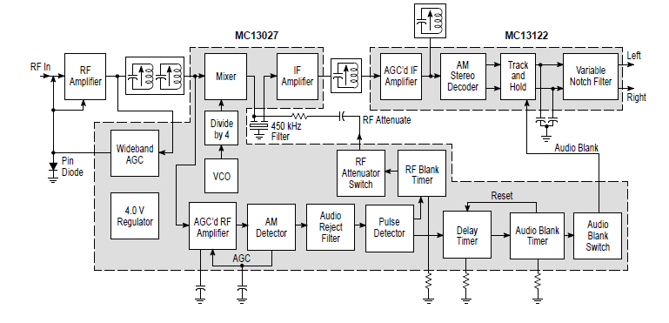
Receiver Noise Rejection
Multi-stage noise limiting (re Motorola CQUAM chips ~1995)
  Antenna input/RF front-end (fast clamp, PIN diode)
  Mixer output (triggered blanker)
  IF output/Detector input (delayed blanker)
  Audio output (delayed sample-&-hold)
  Variable 10-kHz notch filter

Slide 25
DSP Techniques for Receiver Noise Rejection in Kintronic Labs Receiver Under Development
Signal delay with look-ahead processing
Memory storage for signal averaging
Adaptive limiting & blanking (with delays)
SSB/VSB processing for adjacent-channel interference (ACI)
Asymmetric sideband filtering for ACI rejection
Dynamic front-end AGC & Antenna tuning
Fast, dynamic spectral measurements (L_{Alt}, L_{Adj}, On, U_{Adj}, U_{Alt})
Dynamic audio noise reduction/expansion
Fast noise-floor assessment
CQUAM stereo separation correction
Program-dependent bandwidth control (tailored for nighttime)
Synchronous detection for lower distortion & selective fading

Slide 26
Synchronous AM Boosters for Null Fill
Typical cardioid pattern
Synchronous booster fill-in area
Low-power, low-cost synchronous boosters can provide useful fill-ins for covering populated areas lying in pattern nulls.
Boosters can be used daytime and/or nighttime as needed.
Coverage of outlying suburbs can be greatly improved.
Allocations can generally be handled under existing rules.

Slide 27
What are the Potential Benefits to AM?
Elimination of co-channel carrier beats and beat-modulated audio intermodulation effects.
Because AM radio coverage is intrinsically interference-limited, by reducing the co-channel beats we can enlarge the useful coverage area!
Since the carrier is statistically stationary and ~10-12 dB (3-4 ×) above the average modulation sideband power, a significant improvement in listenable coverage area is possible (and fewer tune-outs).
The bottom line: more coverage = more listeners = more revenue!

Slide 28
Existing §73.182 Co-Channel Rules
Class | Channel | Contour (Day) μV/m | Contour (Night) μV/m | Interfer. (Day) μV/m | Interfer. (Night) μV/m
A | Clear | 100 | 500 (50%SW) | 5 | 25
B | Clear Regional | 500 | 2000 (GW) | 25 | 25
C | Local | 500 | ⎯ | 25 | ⎯
D | Clear Regional | 500 | ⎯ | 25 | ⎯
Class A stations are protected to the 0.1 mV/m contour (0.5 night); interferers are ≥ 26 dB down.
Class B, C, & D stations are protected to 0.5 mV/m (2.0 for B at night); interferers ≥ 26 dB down.

Slide 29
Other advantages of synchronization
With static beats eliminated, Doppler shifts must be considered in station mild-overlap areas for mobile receivers; due to fast AGCs, not really a problem.
The technology makes the idea of a synchronous, phase-tracking co-channel low-power AM repeaters feasible for “filling in” poor coverage areas.
In addition, very wide-area single-frequency network broadcasting with satellite audio distribution is also a possibility.
AM stations could be used as reference frequencies!
Receiver AGCs will no longer have to deal with beats.

Slide 30
Field Contours of Overlapping Synchronous AM Transmitters with Typical Mobile-Receiver Trajectories
V₄
V₂
V₃
①
V₁
②
(1) f_{beat}(total) = Σ_{n} f_{beat}(n)
(2) f_{beat}(n) = (νR_{n}cos θ_{n}) (f₀/c)
where f_{beat}(n) is the nth beat frequency, νR_{n} is the velocity relative to station n, θ_{n} is the angle of the trajectory from the radial from station n, f₀ is the original carrier frequency, n is the number of stations, and c is the speed of light.
Maximum Doppler shifts (on path 1) of about ± 0.1 Hz/MHz at receiver velocity of 30 m/s (67 mph).

Slide 31
AM Synchronizer Unit
Typical Block Diagram
MASTER PLL
GPS Timing Receiver
1 PPS
OVCXO 16.777216 MHz
PFD
LPF
1 Hz
÷2²⁴
DDS 1 1.240 MHz
LPF
OUTPUT f₀
Control Microcomputer
DDS 2 2.480 MHz
LPF
OUTPUT 2f₀
Control Panel
Using 2²⁴ Hz as the DDS clock assures that true integer frequencies can be generated!

Slide 32
AM field listening observations
Carrier beats are the dominant effect ⎯ the rates vary from sub-Hertz to about 30 Hz!
In the worst cases, beat frequencies of ~ 20 Hz cause “Donald-Duck” effects and severe distortion on background audio modulations.
Beats are much lower in expanded band (1610-1700 kHz) ⎯ far fewer stations, newer transmitters!
Clutter is horrible on local channels; poor coverage!
Estimated overall typical improvement: 6-10 dB for most stations (talk-oriented).
CD of Lab tests is available – contact us!

Slide 33
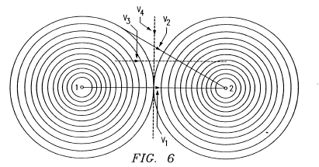
Plot Illustrating Doppler Effects in Mobile Receivers for Synchronous Stations 1 & 2
Original area
Enlarged area
Interference area (2:1)
Int’f. area (Sync’d)

Slide 34
Effective Synchronous Day/Night
Interference-Limited Coverage Improvements (Class B)
New daytime coverage area
New nighttime coverage area
0.5 mV/ m
2.0 mV/ m
1.0 mV/ m

Slide 35
Pros and Cons
Typical enlargement of effective coverage area: ~ 6-10 dB ( factor of 2 to 3 in radius = 4 to 9 in equivalent listening area).
Elimination of all static beats, which are the most objectionable effect and the source of most tune-outs. Doppler ≤ 0.2 Hz/MHz at 30 m/s (67 mph).
Gains greatest for fast music, speech programming.
Reduction in co-channel beats also benefits HD reception; reduced platform motion for CQUAM AM stereo.
Masking usually better on wider-band receivers.
Huge bang for the investment buck for broadcasters!
Minor or no TX equipment modifications; low cost.
Concern: all stations need to synchronize or little benefit!

Slide 36
What can be done to fix AM radio?
Broadcasters, NAB, SBE:
  Adopt synchronous frequency control.
  Install CQUAM stereo exciters with GPS-based frequency sync
  Report known sources of noise to the FCC website
  Work with local congressman and senators to encourage the establishment of new receiver standards
The Commission:
  Mandate synchronization (no economic hardship!)
  Establish a noise study group under the Future of Unlicensed Services Committee of the Technical Advisory Council

Slide 37
What can be done to fix AM radio?
Receiver Manufacturers:
  Employ ± 10-kHz (adaptive) receiver RF/IF bandwidths.
  Include CQUAM stereo decoders.
  Provide 10-kHz notch and selectable/ adaptive IF bandpass filters (±3-10 kHz).
  Employ broadband noise/impulse limiters.
  Utilize synchronous detection circuitry.
  Include very tight RF/IF AGC systems.
  DSP-based processing for best cost, flexibility (e.g., Silicon Labs, NXP, TI, ADI, etc.)
Public:
  Be pro-active in support of high-quality, free AM radio!
  Demand better AM receivers!

Slide 38
The Outlook for AM Broadcasting
SUMMARY
(at least, the way we see it!)
AM, the most spectrally efficient medium, has been essentially technologically orphaned by receiver makers!
Beats and co-channel intermodulation ⎯ the source of most tune-outs ⎯ can be significantly reduced at low cost using carrier-synchronization technology.
The 10-kHz audio bandwidth afforded by NRSC specs, along with CQUAM stereo, can provide very acceptable quality vs. FM for music as well as speech programming.
The industry has done little to deter the generally miserable bandwidth of modern AM radios and has failed to effectively support AM stereo. AM receiver mandates are needed!
The main needs are for better receiver performance and noise enforcement!

